Slide 1
National Emissions Standard for Hazardous Air Pollutants:
Paint Stripping and Miscellaneous Surface Coatings Operations at Area Sources Overview and Training
EPA Rule 40 CFR Part 63 Subpart HHHHHH
“The Refinisher Rule”

Slide 2
Contents
Section One – Overview and Resources:
  Purpose
  Rule Overview and Training Requirements
  Coatings covered by the Rule
  Compliance dates
  Spray Area Requirements and Booth/Filter Maintenance
  Equipment: what is covered and not covered
  Notification and Record-keeping requirements for Shops
  Resources
Section Two – Paint Technician Training:
  Training Objectives
  Spray Training for Paint Technicians
  Maximizing paint efficiency: Tools for getting the most from your paint
  Post-Training Review

Slide 3
Section One
Objectives and Overview

Slide 4
Environmental Regulatory Update and Training
Purpose of this presentation:
  Provide overview of EPA Rule 40 CFR Part 63 Subpart HHHHHH requirements for Surface Coatings Operations at Area Sources
  Provide materials for Collision Center owners/managers as part of their overall documentation of compliance with EPA Rule 40 CFR Part 63 Subpart HHHHHH
  Provide specific training components for Paint Technicians
Notes:
Rule is known as ‘6-H’

Slide 5
What’s in a name?
EPA Rule 40 CFR Part 63 Subpart HHHHHH
Known by many names:
  The Refinisher Rule
  Rule 40
  6H
  Subpart HHHHHH
  NESHAP
  NESHAPs
  National Area Source Rule
  Refinish Area Source Rule
    …and probably a few others
All refer to the same EPA Rule

Slide 6
EPA Rule 40 CFR Part 63 Subpart HHHHHH
Overview:
HAPs Regulation
In January 2008, the US EPA published the National Emissions Standards for Hazardous Air Pollutants: Paint Stripping and Miscellaneous Surface Coatings Operations at Area Sources.
EPA established this Rule to control the emissions of target HAPs in the collision center environment and surrounding community.
Four basic requirements for Collision Centers:
  Initial Notification of EPA by Collision Center (due in 2010)
  Compliance and notification by Collision Center (due not later than 2011)
  Training of paint spraying personnel
  Record-keeping by Collision Center

Slide 7
EPA Rule 40 CFR Part 63 Subpart HHHHHH
This EPA Rule covers two primary operations:
  Paint Stripping Operations
  Spray Coatings Operations

Slide 8
EPA Rule 40 CFR Part 63 Subpart HHHHHH
Paint Stripping
  Paint stripping operations using Methylene Chloride (MeCl) for the partial or complete removal of surface coatings from wood, metal or plastic substances are subject to this EPA Rule
  Requirements for MeCl paint stripping operations:
    Optimization of stripper application
    Proper storage and disposal of MeCl bearing material
    MeCl Minimization Plan for use greater than 1 ton per year
  What the Collision Center must do:
    Identify methods of paint stripping used and the substrates stripped
    Include method and substrate information on initial Notification to EPA
    Indicate on Notification if Collision Center plans annual use of MeCl exceeding 1 ton

Slide 9
EPA Rule 40 CFR Part 63 Subpart HHHHHH
Surface Coating
  Motor Vehicle and Mobile Equipment Surface Coating Operations – involve spray application of coatings at area sources to automobiles, light trucks, heavy duty trucks, buses, construction equipment, self-propelled vehicles and equipment that may be drawn and/or driven on a highway
  Miscellaneous Surface Coating Operations – involve the spray application of coatings that contain compounds of target HAPs to miscellaneous parts and/or products made of metal or plastic, or combinations of metal and plastic
  Requirements:
    HVLP, Electrostatic, Airless, Air assisted Airless spray guns or a gun with demonstrated equivalency of transfer efficiency of HVLP
    all spray application of coatings in a prep station or spray booth
    booth exhaust filters must have demonstrated filter efficiency of 98%
    enclosed gun cleaner or disassembled cleaning
    spray painter training

Slide 10
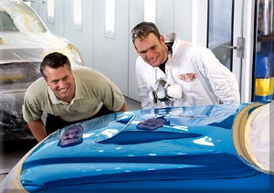
EPA Rule 40 CFR Part 63 Subpart HHHHHH
Requires Paint Technicians to be trained on:
  The general provisions of the Rule
  Roles requiring training
  Coatings covered by this Rule
  Compliance dates
  Spray Areas and equipment requirements in the Shop
  Spray Gun Requirements
    Spray Gun Set-Up for best transfer efficiency
    Spray Gun Operation for best transfer efficiency
    Spray techniques to improve transfer efficiency
    Spray gun cleaning

Slide 11

Training is required for:
All painters who work on motor vehicles and mobile equipment surface coatings operations that involve the spray application of coatings at area sources to:
  Automobiles
  Light trucks
  Heavy duty trucks
  Buses
  Construction Equipment
  Self-propelled vehicles
  Any equipment that may be drawn and/or driven on a roadway
  Also applies to painters who spray apply HAP-containing coatings to miscellaneous metal parts

Slide 12
Training is also required for…
Painters who spray apply target HAP-containing coatings to miscellaneous metal parts. Target HAPs are:
  Chromium (Cr)
  Lead (Pb)
  Manganese (Mn)
  Nickel (Ni)
  Cadmium (Cd)
All shops could have a number of colors and/or primers with one or more of the targeted HAPs. Consult product MSDS.
Shop can petition EPA (in initial notification) if it can prove that all coatings being used do not contain any target HAPs. This petition does not guarantee exemption.
Notes:
Even shops that successfully petition must still spray in enclosed booths.
Instructor provides a product list of products that contain target HAP.
Shop using MasterTint will have 3 powdered pearls that fall into the target HAP category. Reference the product list of target HAP products. The reality is few shops (if any) will actually receive an exemption from the EPA. The Rule is aimed at reducing overspray and emissions in the shop and in the surrounding communities.

Slide 13
Compliance dates
As of January 9, 2008:
  New shops (shops that have begun spraying since 9/17/2007) must comply immediately
  Existing shops must have complied by January 10, 2011
Painters must be trained within the next two years
Training will be good for 5 years, and refresher must be repeated every 5 years
All spray painters at new sources (new shop employment location) must complete training no later than 180 days after hiring
All painters must have a certificate to show date of training
Shops must notify EPA that they are subject to Rule by 01/11/2010 (initial notification), and submit notification of compliance status by 3/11/2011
Notes:
New shops and new sources (that is an existing shop with a new booth) must comply immediately

Slide 14
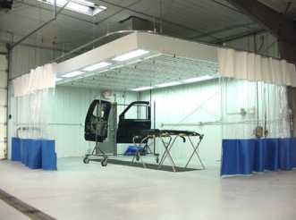
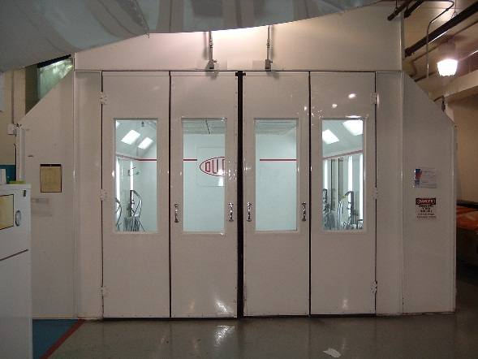
Spray Area
All spray-applied coatings must be used in a prep station or spray booth
Prep stations and spray booths large enough to fit a vehicle must have four side walls or curtains and a full roof
Parts must be sprayed in a booth with at least three side walls or curtains and a full roof
Booth and prep station filters must achieve 98% filter efficiency of overspray

Slide 15
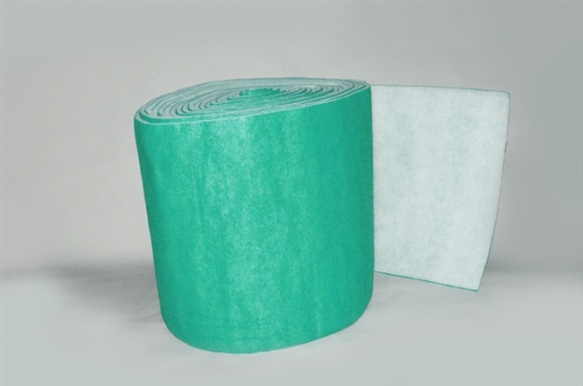
Booth Filters
Booth filters improve job quality and protect environment
  Allow air to flow evenly
  Captures overspray, decreases emissions
Rule Requirement: 98% or greater efficiency for exhaust filters
  Establish and document filter change-out schedule and procedure
  Maintain documentation from filter manufacturer that filters are 98% efficient

Slide 16
Approved Equipment
HVLP (defined as 65% Transfer Efficient (TE) and 10 psi at cap)
Electrostatic spray guns
Airless spray guns
Air Assisted spray guns
Any non-HVLP gun demonstrated to achieve 65% TE with manufacturer documentation
  Check local regulations – if local laws are more strict, they may over-rule national laws
  All motor vehicle and mobile equipment spray coating operations and miscellaneous surface coating operations with a cup size larger than 3.0 ounces or 89cc must comply with this Rule
Notes:
Cups smaller than 3.0 ounces are permitted – for pinstriping and touch-ups. Gun manufacturers provide documentation for non-HVLP, 65%

Slide 17
Activities Exempted from Rule
Spray applications using a hand-held device with cup capacity no more than 3 fluid ounces (89cc)
Powder coating
Hand-held, non-refillable aerosol containers
Non-atomizing technology
Thermal spray operations using solid metallic or non-metallic materials
Notes:
Hobbyists or personal use (2 cars or less a year) and non-profits excluded.
Non-atomizing technology includes: brushes, rollers, hand-wiping; flow, dip, electro-deposition, web, and coil coatings techniques; and touch up markers or marking pens

Slide 18
Notification and Record-keeping Requirements
Notifications:
  Initial notification to EPA or delegated state agency that Collision Center is subject to the rule – that is, that the Collision Center is an area source
    New Source – w/in 180 days after start-up or publication of final rule, whichever is later
    Existing Source – 1 year before compliance date: January 9, 2010
  Notification of compliance status to EPA or delegated state agency
    New Source – 180 days after compliance date for the facility
    Existing Source – 30 days after compliance date for the facility (30 days after January 9, 2011)
  States or local authorities may have more strict rules. Check your local authorities for any other rules.

Slide 19
Notification and Record-keeping Requirements
Recordkeeping by the Collision Center*:
  Copies of Notifications submitted to EPA
  Painter training certifications
  Spray booth filter efficiency documentation
  Spray gun transfer efficiency
  MeCl content information such as MSDS
  Annual usage of MeCl for paint stripping, and written MeCl minimization plan if annual usage > 1 ton per year
  Deviation and corrective action documentation
*Records to be maintained in a form suitable and readily available for expeditious review by EPA

Slide 20
Resources
For more information on EPA Rule 40 CFR Part 63 Subpart HHHHHH go to:
www.epa.gov/ttn/atw/area/fr09ja08.pdf
www.epa.gov/collision-repair-campaign
www.epa.gov/ttn/atw/area/autobodybs.doc
www.epa.gov/ttn/atw/area/arearules.html
For a video overview of the Rule (English and Spanish) and for more information on Axalta products and recommendations go to: https://www.epa.gov/collision-repair-campaign/outreach-materials-collision-repair-campaign
Notes:
Instructor Note: be prepared to visit and review these websites

